Slide 1
Welcome!
Question of the Day:
Are you traveling this weekend?
‹#›

Slide 2
8.2 Object State and Behavior
CAROL RAMSEY
GDC 6.318
ramsey@cs.utexas.edu
Notes:
rework flow

Slide 3
New Quizzes Start Monday
Instead of 2-question Canvas quiz at beginning of class, y’all will take a photo (or 2) of your practice paper and submit to Canvas quiz at the end of class. 6 points for submitting, 10 points for completing the work. It does not have to be correct. Submission opens and closes at end of class, :48 - :50.

Slide 4
Announcements
Tests will be returned in Section on Monday.

Slide 5
Review

Slide 6
Boolean Zen

Slide 7
Rubber Duck Debugging
Beg, borrow, steal, buy, fabricate or otherwise obtain a rubber duck (bathtub variety).
Place rubber duck on desk and inform it you are just going to go over some code with it, if that’s all right.
Explain to the duck what your code is supposed to do, and then go into detail and explain your code line by line.
At some point you will tell the duck what you are doing next and then realise that that is not in fact what you are actually doing. The duck will sit there serenely, happy in the knowledge that it has helped you on your way.
from Andrew Hunt and David Thomas, The Pragmatic Programmer

Slide 8
8.2 Object State and Behavior
Notes:
Session Title: Project Based Learning (PBL) for Equity in CS classes
Session Description: If you are teaching a survey course like Computer Science Principles, or a code intensive course like AP CS A, PBL can serve as a powerful tool to increase student interest and engagement. Learn about research that connects PBL to improved student outcomes, especially for girls and underrepresented minorities. Discover available PBL resources and understand PBL lesson components, so you can build your own.

Slide 9
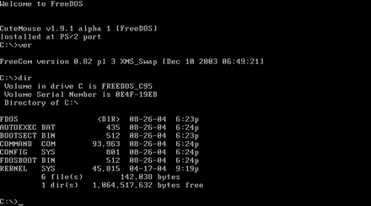
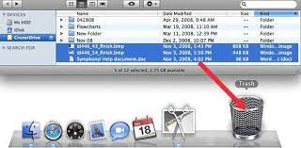
Functional vs. Object-Oriented
verb + noun noun + verb
Photos courtesy of https: wikipedia.com and https://www.google.com/url?sa=i&url=https%3A%2F%2Frecoverit.wondershare.com

Slide 10
Create our own type, a point
Point Class
Client Program with main()
Fields
x
y
Point point1 = new Point();
point1.setLocation (8, -2);
double d = point1.distanceFromOrigin();
System.out.println(point1.toString());
Methods
setLocation()
distanceFromOrigin()
translate()
toString()

Slide 11
Point Class as a Blueprint
Point class
state: int x, y
behavior: setLocation(int x, int y) translate(int dx, int dy) distanceFromOrigin() draw(Graphics g)
Point object #1
state: x = 5, y = -2
behavior: setLocation(int x, int y) translate(int dx, int dy) distanceFromOrigin() draw(Graphics g)
Point object #2
state: x = -245, y = 1897
behavior: setLocation(int x, int y) translate(int dx, int dy) distanceFromOrigin() draw(Graphics g)
Point object #3
state: x = 18, y = 42
behavior: setLocation(int x, int y) translate(int dx, int dy) distanceFromOrigin() draw(Graphics g)

Slide 12
Demo
Code
Create Point.java
(solution on next 3 slides)

Slide 13
Class Fields
Declared at the beginning of the class.
Fields are the data for the object.
Each object created has its own copy of the fields.

Slide 14
Class Methods
Defined after the class fields.
Methods are defined for the actions related to the class.

Slide 15
The Implicit Parameter
implicit parameter: The object on which an instance method is called.
During the call city1.draw(gr); the object referred to by city1 is the implicit parameter.
During the call city2.draw(gr); the object referred to by city2 is the implicit parameter.
The instance method can refer to that object's fields.
draw can refer to the x and y of the object it was called on.
Can use the keyword this to refer to the implicit parameter.

Slide 16
Demo
Code
Create points in PointMain.java

Slide 17
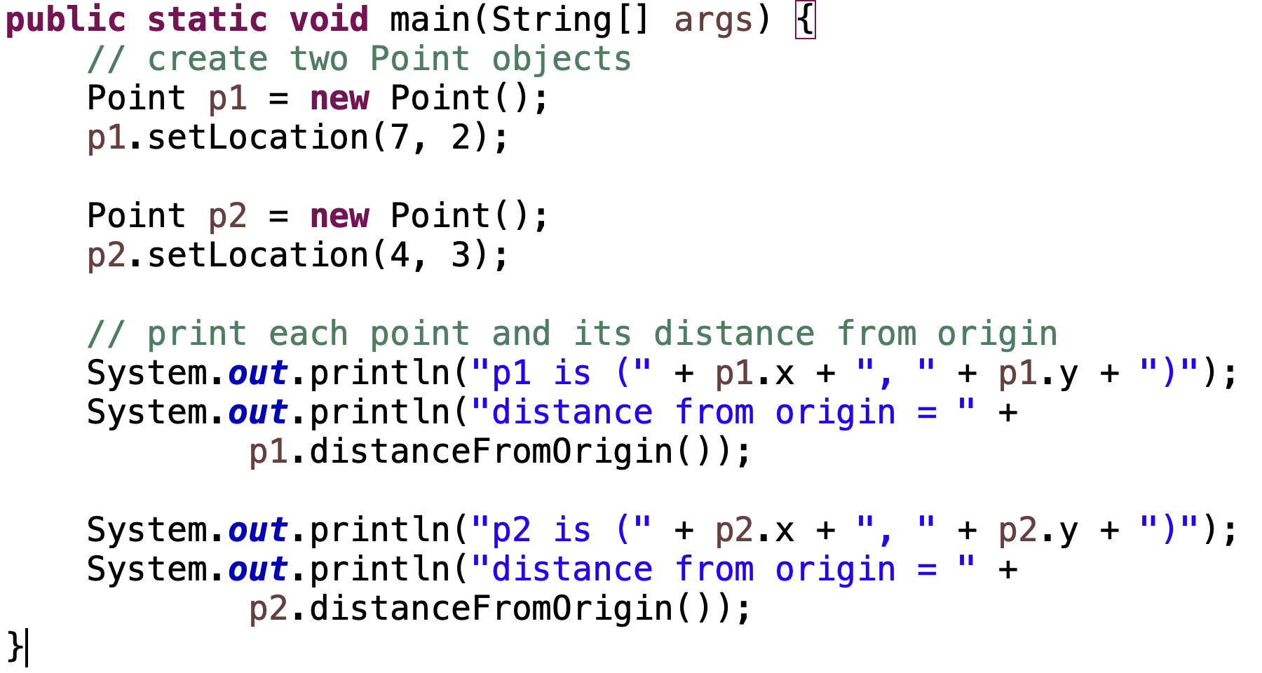
Solution

Slide 18
Demo
Code
Update setValues() to use this.

Slide 19
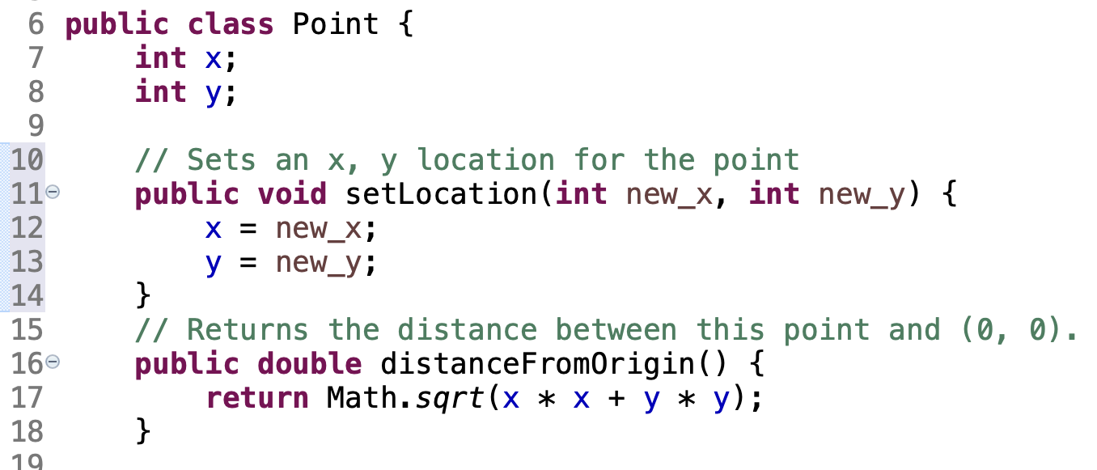
Point.java Can’t Execute on Its Own
Point.java by itself isn’t a runnable program.
Must have another client program with a main() method to create point objects and use them.

Slide 20
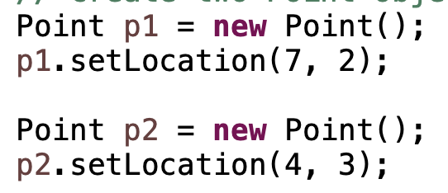
Array of Objects
We know that this won’t work when we have 100000 points:
So, we create an array of Points.
<Type> <variable name> = new <Type>[<size>]

Slide 21
Demo
Code
Create array of points in PointMain.java
(attempt 1)

Slide 22
Two-Phase Initialization
1) Initialize the array itself (each element is initially null)
Point[] points = new Point[4]; // phase 1
2) initialize each element of the array to a new object.
for (int i = 0; i < points.length; i++) {
points[i] = new Point(); // phase 2
points[i].setValues (6, -2);
}
index | 0 | 1 | 2 | 3
value | Null | Null | Null | Null
points
index | 0 | 1 | 2 | 3
value | xxx | yyy | zzz | xzxzxz
points
points[0]
x = 0
y = 0
points[1]
x = 0
y = 0
points[2]
x = 0
y = 0
points[3]
x = 0
y = 0

Slide 23
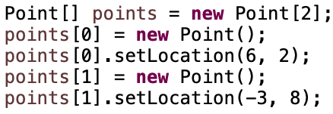
Solution

Slide 24
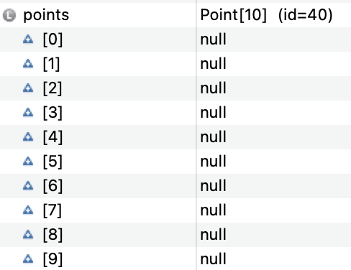
Null
Null: A value that does not refer to an object.
Used when a variable in memory created to store the address of an object doesn’t have an address.
When an array of objects is
declared, all values are
initialized to Null.

Slide 25
What you can do with null
Null means nothing, but it is very real. You can:
store null in a variable or an array element
Point point1 = null;
print a null reference
System.out.println(point1); // null
ask whether a variable or array element is null
if (point1 != null) { ...
pass null as a parameter to a method
System.out.println(null); // null
return null from a method (often to indicate failure)
return null;

Slide 26
null Pointer Exception
dereference: To access data or methods of an object with the dot notation, such as s.length() .
It is illegal to dereference null (causes an exception).
null is not any object, so it has no methods or data.
Point[] points = new Point[5];
points[0].setValues (6, 5);
Output:
Exception in thread "main" java.lang.NullPointerException
at Example.main(Example.java:8)
index | 0 | 1 | 2 | 3 | 4
value | null | null | null | null | null

Slide 27
Look Ahead for null
You can check for null before calling an object's methods.
Point[] points = new Point[5];
points[2].x = 8;
points[2].y = 0;
for (int i = 0; i < points.length; i++) {
if (points[i] != null) {
System.out.println(points[i].x, points[i].y);
}
}

Slide 28
In-Class Practice
Remember:
Distance between two points is
City.java
Add an accessor method named getDistance() to return the distance between a city and another x, y point. You have these fields and constants available:

Slide 29
Solution

Slide 30
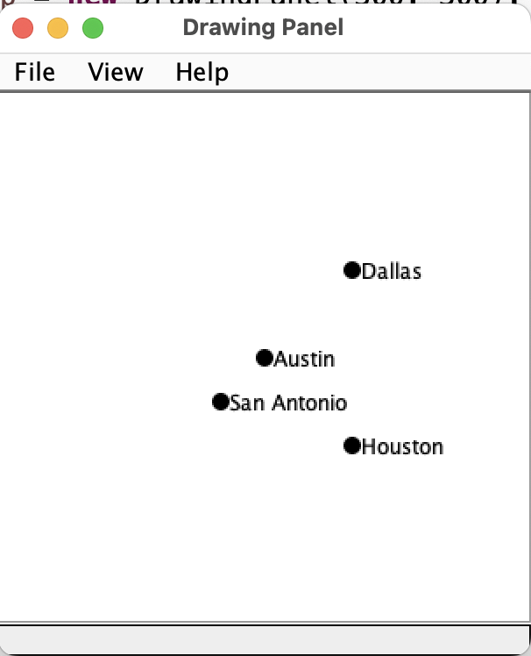
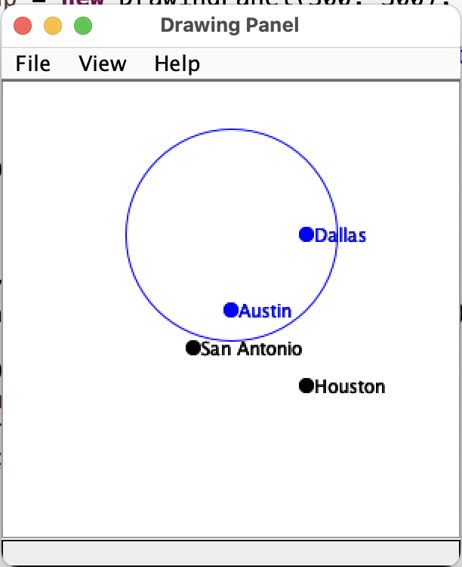
In-Class Practice
Before rain:
After rain:
RainMain.java
Complete the rain() method to update the graphic based on rain that makes a perfect circle, at a given x,y center location and r radius. Use this main() and your new getDistance() method.

Slide 31
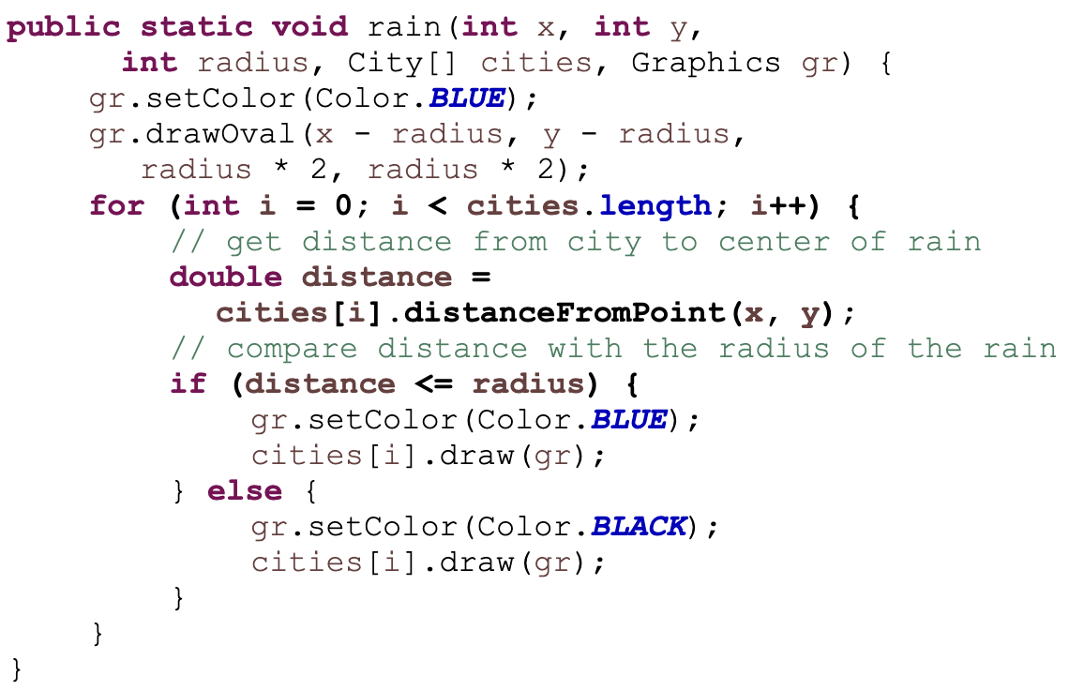
Solution

Slide 32
Class Methods
We could write a method in RainMain.java to draw all the cities:
But:
If cities are drawn in multiple places in the client program, the code would need to be repeated.
If the drawing of cities changes, it needs to be changed in multiple places.
The client program would need to have access to the OFFSET and CIRCLE_SIZE constants, which really belong in the city class.
The city class is in charge of all things about city. It should define how to draw a city.

Slide 33
Updated draw()
In client program:
In City.java:

Slide 34
Class Methods that are Not Static
Notice this is not a static method:
Static methods apply to the class itself, not an individual object.
Instance methods apply to each individual object in memory.
They don’t use the static keyword.
They have access to the fields of the object that called the method, for example, city[2].draw() accesses x and y for city[2].
Most methods of a class intended to create objects are instance methods.

Slide 35
Updated draw() Revisited
In client program:
In City.java:
When city[0] calls draw(gr),
city[0]’s x and y are used in the instance method.

Slide 36
Printing Objects
Printing an object will get a text version of the memory address of that object. This code:
prints this output:

Slide 37
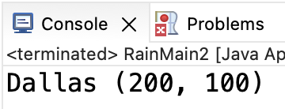
toString() method
It’s common for classes to define a toString() method to print itself.
toString is a special method.
If a class provides one, Java will find it when you reference the object as a String, for example, in a println statement.
In City.java:
In RainMain.java:
Results:

Slide 38
toString() details
toString() method must meet these requirements exactly.
String return type
String return
Named toString
No parameters

Slide 39
Vocabulary
Description | Pattern
null | A Java keyword that indicates an object that points to nothing.
field | A variable inside an object that is part of its state.
instance method | Exists inside each object of a class and gives behavior to each object. For example, the title of a Book class.
client program | A program that creates and changes objects. The client program generally (for smaller program at least) has a main() and is functional in nature.

Slide 40
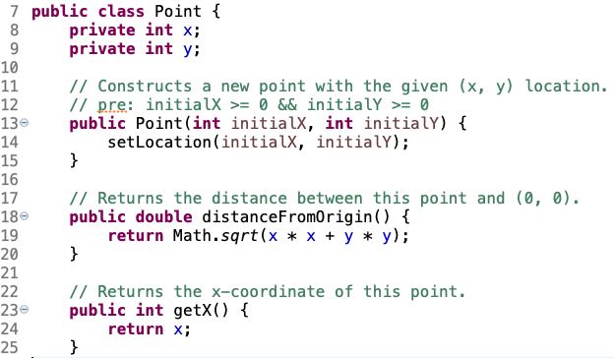
Syntax - Class
Class name
Fields
Methods
Constructor
A blueprint for a point. Nothing exists in memory at runtime until a client program uses new to create an object based on this class.
Accessor
Mutator

Slide 41
Remember
You Belong Here
Hi!

